Slide 1
Lecture 20: The Safe Drinking Water Act
Prof. Austin
Environmental Economics Econ 4075

Slide 2
Why Regulate Drinking Water?
Unlike surface waters and air quality, public drinking water is generally sold at a price to consumers. It is also mostly a local public good. There are nevertheless a few economic cases for national regulation.
Information asymmetries:
Full list of potential contaminants
Dose-specific toxicological impact
Many public water systems are natural monopolies.
Aside from economics, the UN has declared safe drinking water access a human right.

Slide 3
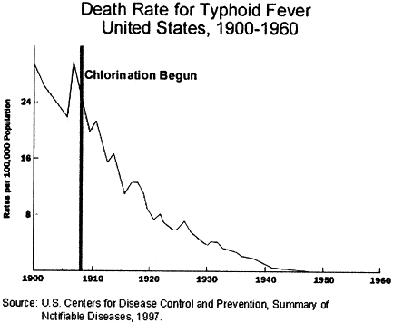
History of Drinking Water Regulation
Many prior efforts to regulate drinking water before SDWA.
Widespread chlorination of drinking water supplies in the 1920s reduced the average risk of death from waterborne disease from 5% over a lifetime to 0.03% by 1940 (Morris, 2007).
Differences-in-differences was invented by John Snow, a physician studying cholera in London.
Source.

Slide 4

History of Drinking Water Regulation
A former brewer named Johannes Rook detected chloroform in public drinking water supplies from the Amstel River in 1970. A 1972 International Agency for Research on Cancer suggested chloroform could cause cancer. The story was later picked up by the Miami Herald. Other stories followed, such as regarding “chemical-tasting” water on the Mississippi.
Shortly thereafter, the Safe Drinking Water Act was passed in 1974. While the Clean Water Act regulates discharges to surface waters, SDWA regulates contaminants at the tap and the practices of public drinking water systems.
Image created using Dall-E.

Slide 5
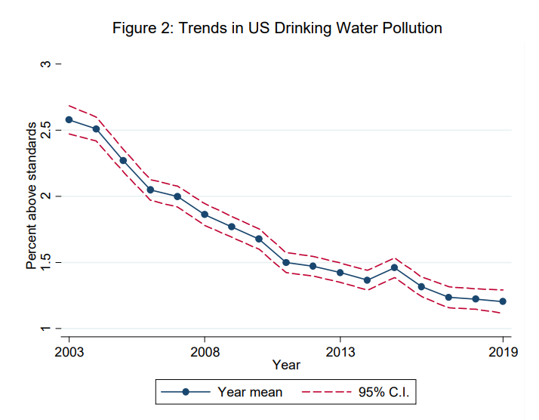
Has SDWA Been a Success?
Difficult to measure given current reporting practices, but recent research suggests yes.
Broad decreases across all regulated contaminants.
Mortality benefits of standards alone are 20x costs of grants to improve water quality.
Source: Keiser et al. (2023)

Slide 6
Part 1: Regulatory Instruments in SDWA

Slide 7
Regulatory Instruments in SDWA
The Safe Drinking Water Act has three main regulatory instruments.
Regulating Contaminants
Maximum Contaminant Levels
Treatment techniques
Monitoring Requirements and Reporting Requirements
Consumer confidence reports
Public notification
Subsidy programs
The Drinking Water State Revolving Fund (SRF)
The Safe Drinking Water Act does not regulate private wells or bottled water.

Slide 8
1) Regulating Contaminants
EPA regulates 94 contaminants in drinking water. To regulate a new contaminant, the EPA has to rigorously establish three requirements:
The contaminant occurs with sufficient frequency in public water systems.
The contaminant is harmful to public health.
There is a meaningful opportunity for public health risk reductions.
Solely the administrator must determine if these three criteria are met for any given contaminant.
States and local jurisdictions can regulate more chemicals than the national requirements.

Slide 9
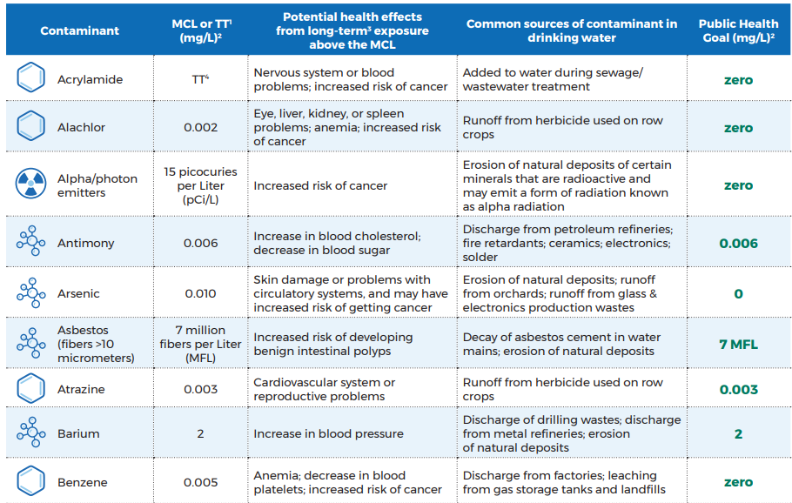
Maximum Contaminant Levels
Most contaminants are required to be below a maximum contaminant level (MCL) or concentration.
The MCL is based as low as feasible given cost, treatment technology, and other considerations.
The MCL Goal is a health-based threshold at which no effects are likely to occur.
See full list of MCLs and other contaminant thresholds.

Slide 10
Common Classes of Contaminants
Disinfection Byproducts
Total Trihalomethanes
Haloacetic acids
Bromate
Inorganic Chemicals
Arsenic
Cadmium
Chromium
Nitrates
Organic Chemicals
Pesticides (e.g., atrazine)
PCBS
Dioxins
MCLs are more common for contaminants that may be found in source-water.
Radioactive particles
Radium
Uranium
Alpha particles

Slide 11
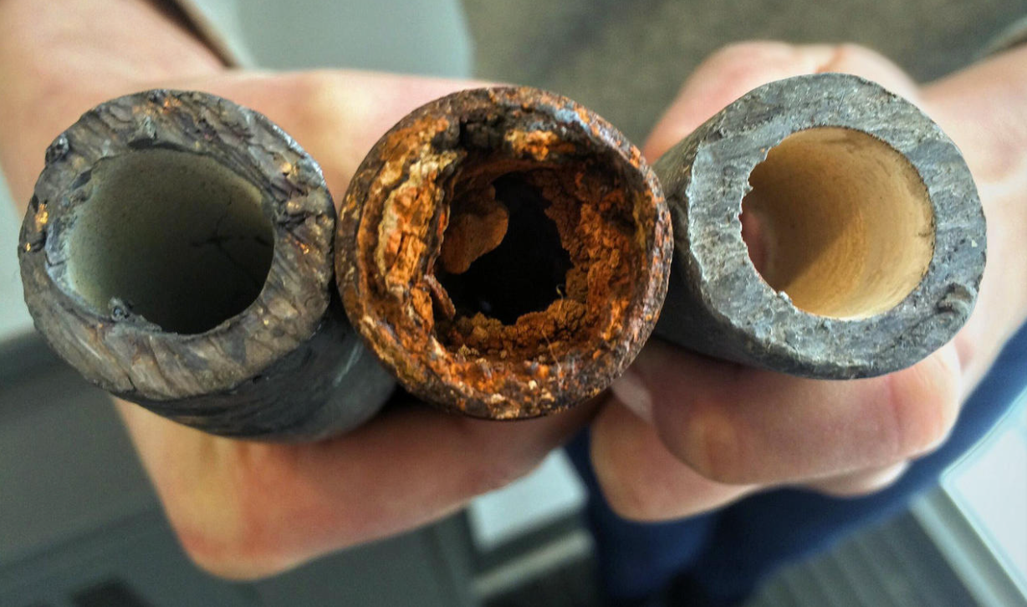
Treatment Techniques
The two major treatment technique regulations:
Lead and copper rule
Action level of 0.015 mg/l for the 90th percentile sample concentration of lead.
Action level of 1.3 mg/l for the 90th percentile sample concentration of copper.
Total Coliform Rule
No more than 5% of total coliform samples.
Any detection of E. Coli in addition to a routine total coliform sample.
If a violation of these rules takes place, the water system needs to take corrective action to address the potential deficiency and return to compliance.
Figure: Most lead in drinking water comes from pipe and fixture corrosion (image source).

Slide 12
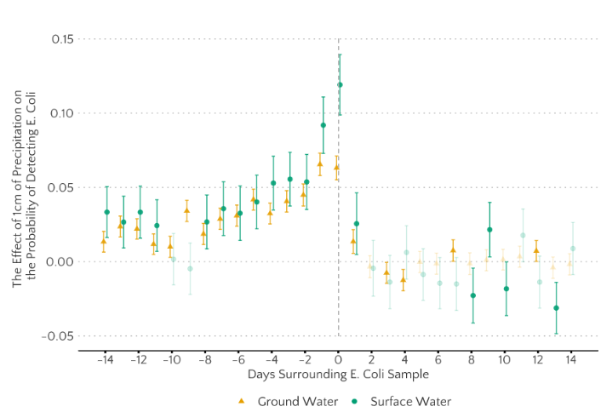
Why not an MCL?
E. Coli detection Before and After Heavy Rains
Part of the rationale for the treatment technique approach is that the contaminant may come from the distribution network or deficient water system practices. In some cases, treatment technique changes are the only way to manage the concern.

Slide 13
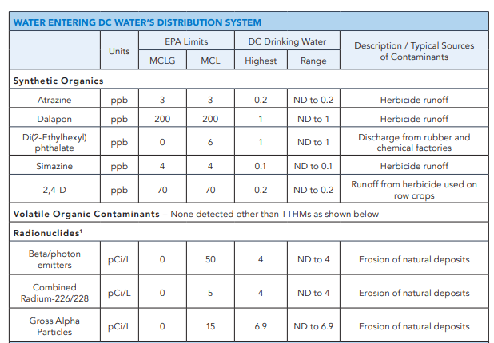
2) Notification Requirements
The 1996 amendments to SDWA, promulgated after a notable cryptosporidium outbreak, created new information requirements.
Consumer confidence reports show key information:
Where drinking water comes from
Any detected contaminants
Comparison to national detection rates.
Timely public notification of any violations or deficiencies.
A snippet of DC Water’s 2021 Consumer Confidence Report.

Slide 14
2) Notification Requirements
Information disclosure required under the 1996 amendments appear to have been effective in lowering water quality concerns.
Using data from Massachusetts from 1990-2003, Bennear and Olmstead (2006) show that annual consumer confidence reports:
Reduced total violations by 30-44% overall.
Reduced the most-serious violations by 40-57%.
Suggests that information asymmetries are a valid concern regulating water systems, but also that disclosures are not enough to ensure complete water safety.

Slide 15
3) Drinking Water State Revolving Fund
Funds are allocated to drinking water systems through a grants, loans, and financing from the Drinking Water State Revolving Fund.
Promotes activities such as:
Renovating drinking water treatment facilities.
Replacing lead service lines, corroded pipes, and maintaining the distribution network.
Water supply infrastructure such as wells, pipes, etc.
State programs like water manager training, source-water protection oversight, etc.

Slide 16
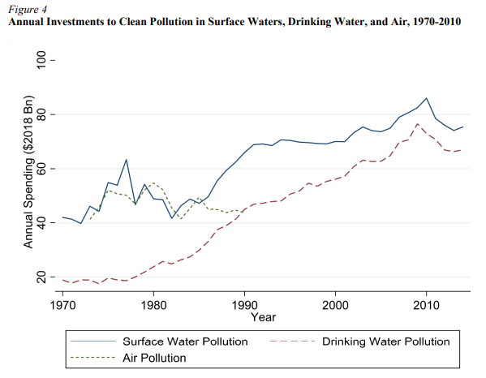
3) Drinking Water State Revolving Fund
Roughly $2 trillion was spent from 1970 to 2014 on protecting drinking water quality activities, the same as was spent on air pollution mitigation but less than surface water pollution mitigation (Keiser and Shapiro, 2019).

Slide 17
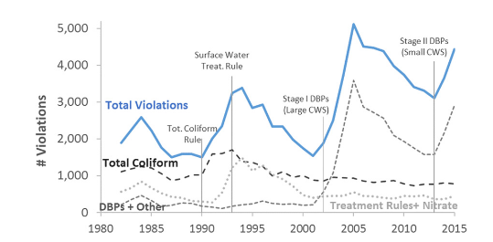
How Does SDWA Change over Time?
SDWA requires certain practices on strict timelines to ensure continued regulation of emerging contaminants. Key steps:
The contaminant candidate list, which must be updated every five years.
List of 2022 contaminant candidates.
Unregulated contaminant monitoring rule (UCMR) for some contaminant candidates.
Regulatory determinations for UCMR contaminants and then creation of a new National Primary Drinking Water Regulation (NPDWR).
None since 2006. It is very difficult to pass new NPDWRs.
Revisions to prior rules through the 6-year review process.
One major revision since 1996 (the Total Coliform Rule).
Health-based violations, from Allaire et al. (2018).

Slide 18
Part 2: Topics on Drinking Water

Slide 19
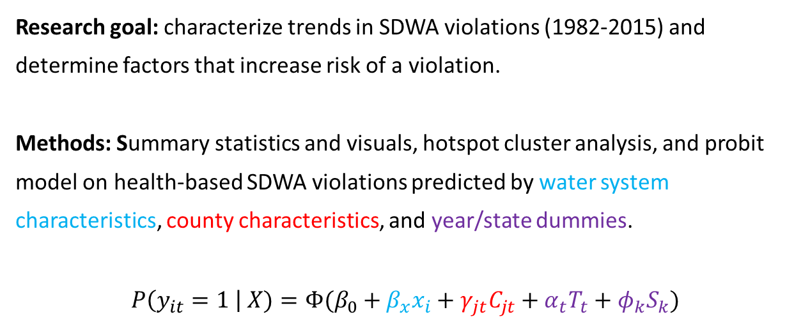
Allaire et al. (2018)
Research goal: characterize trends in SDWA violations (1982-2015) and determine factors that increase risk of a violation.
Methods: Summary statistics and visuals, hotspot cluster analysis, and probit model on health-based SDWA violations predicted by water system characteristics, county characteristics, and year/state dummies.
$$P\left(y_{it}=1 \right| X)=Φ(β_{0}+β_{x}x_{i}+γ_{jt}C_{jt}+α_{t}T_{t}+φ_{k}S_{k})$$

Slide 20
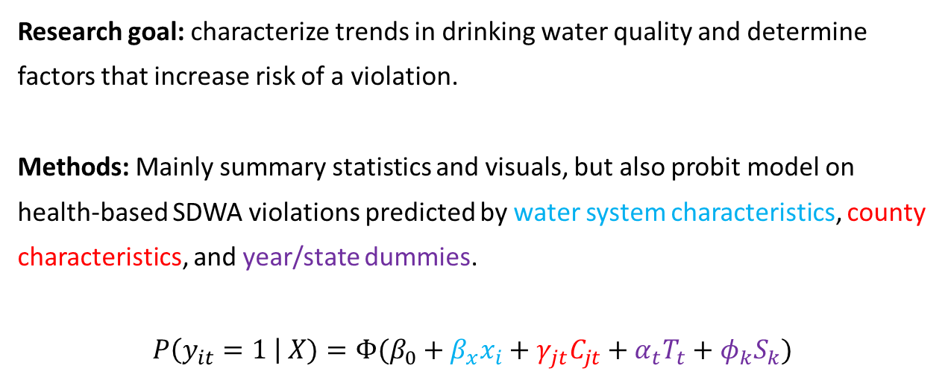
Allaire et al. (2018)
Research goal: characterize trends in drinking water quality and determine factors that increase risk of a violation.
Methods: Mainly summary statistics and visuals, but also probit model on health-based SDWA violations predicted by water system characteristics, county characteristics, and year/state dummies.
$$P\left(y_{it}=1 \right| X)=Φ(β_{0}+β_{x}x_{i}+γ_{jt}C_{jt}+α_{t}T_{t}+φ_{k}S_{k})$$
Type of source water, service population, and ownership type.
Household income, housing density, and percent nonwhite population

Slide 21
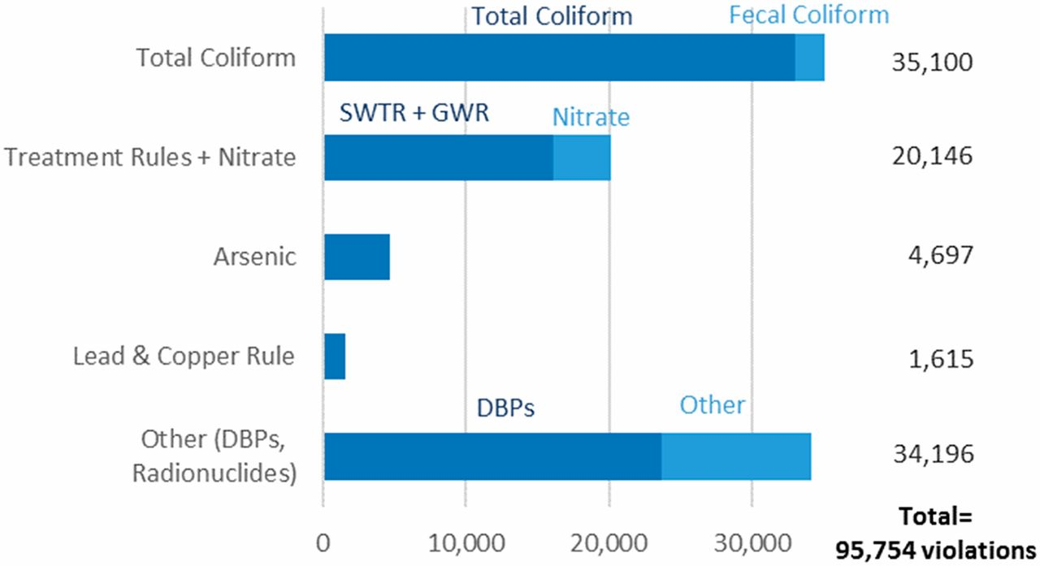
Allaire et al. (2018)
Select Findings:
In any given year from 1982-2015, 7-8% of systems have a health-based violation.
Total coliform violations are the most common.
Risk factors for violations:
Past violations
Public water system (non-private)
Rural small water systems
Lower income

Slide 22
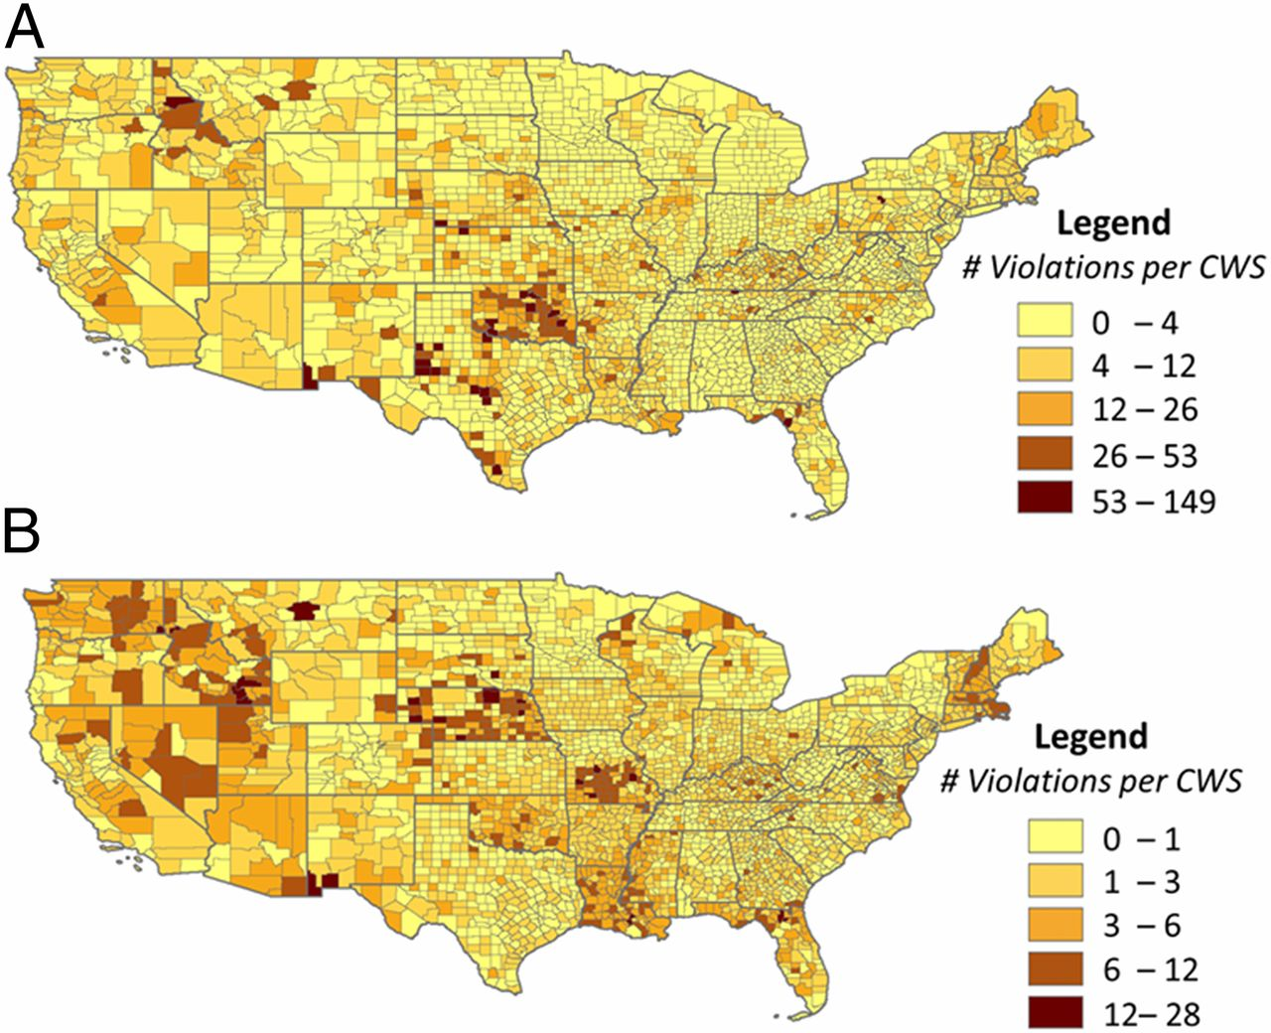
Total SDWA Violations per CWS by County
Total Coliform Violations per CWS by County

Slide 23
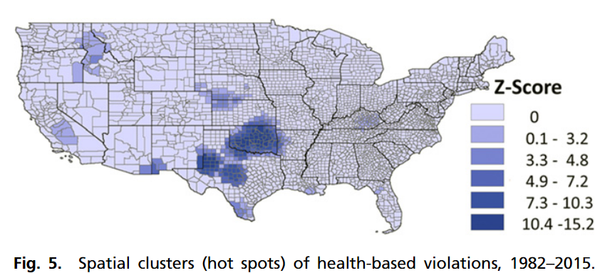

Slide 24
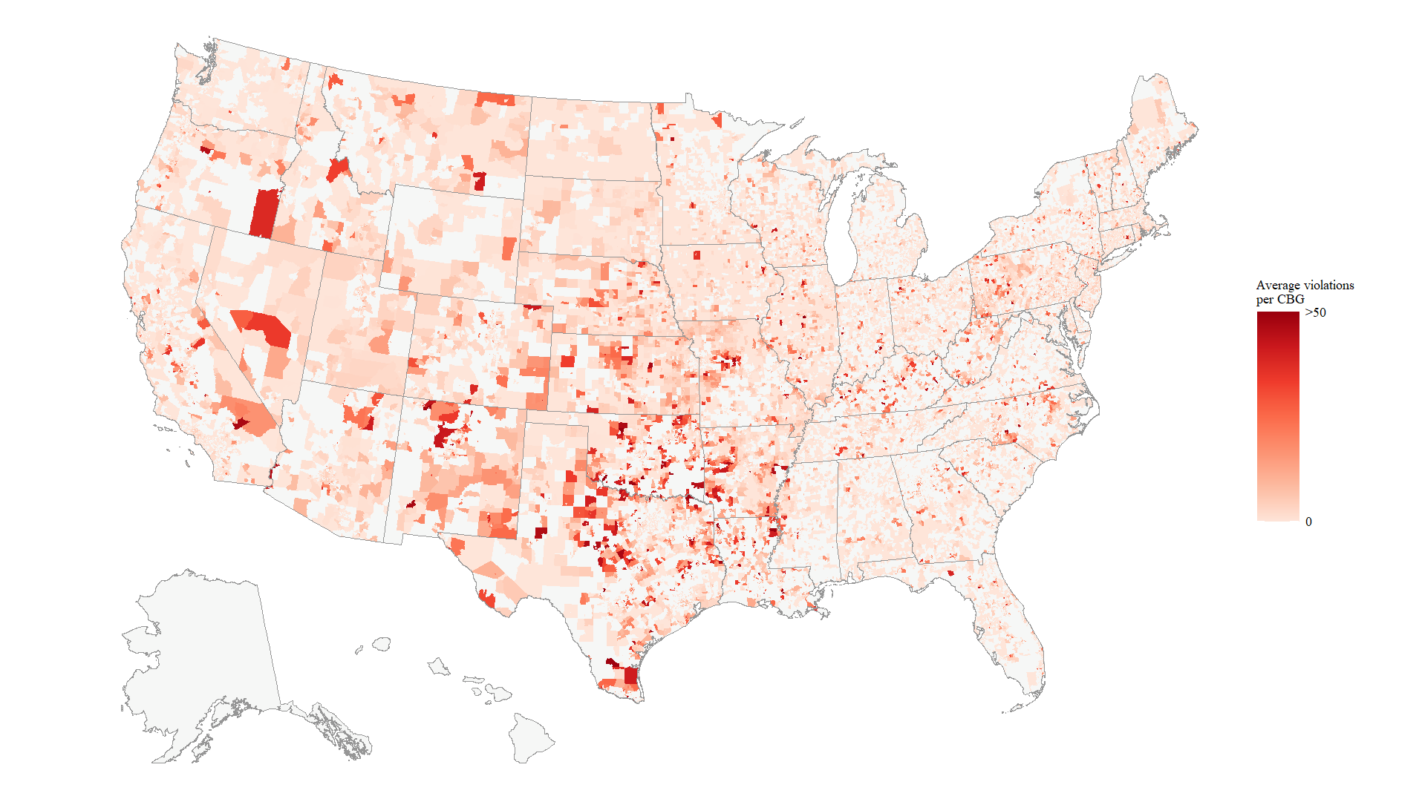
Health-Based Violations (2015-2023)

Slide 25
Allaire et al. (2018)
Some other considerations:
Why only 18,000 water systems?
There are over 150,000 total systems in the US today.
Reporting and monitoring violations are excluded. Why?
What does a violation really represent?

Slide 26
Pullen Fedinick et al. (2022)
Research goals:
Characterize overall counts of SDWA violations and population affected (2016-2019).
Determine correlations between violation count, health-based violation count, and CDC social vulnerability indicators (socioeconomic, minority status and linguistic isolation, and household composition).
List concrete solutions.
Methods:
Narrative
Case studies
Summary statistics
Correlation plots
Visualizations (chloropleths)

Slide 27
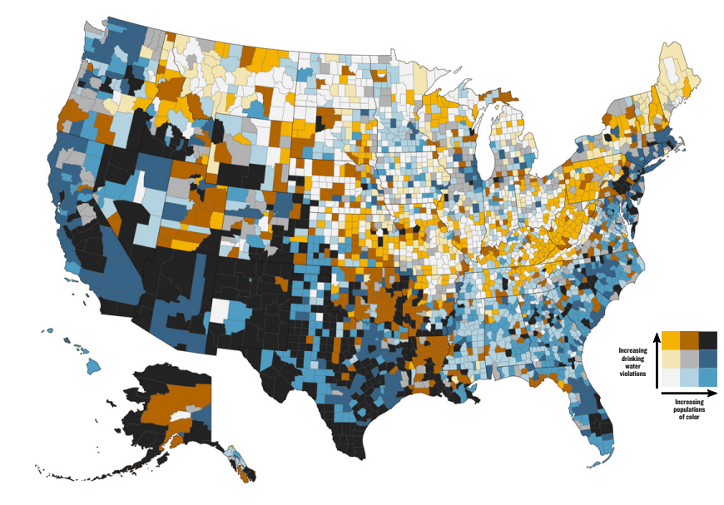
Select findings:
130 million people were served by water systems that had some type of violation from 2016-2019.
45 million served by systems with health-based violations.
Counties with more minority and linguistically isolated individuals have more total violations and health-based violations.

Slide 28
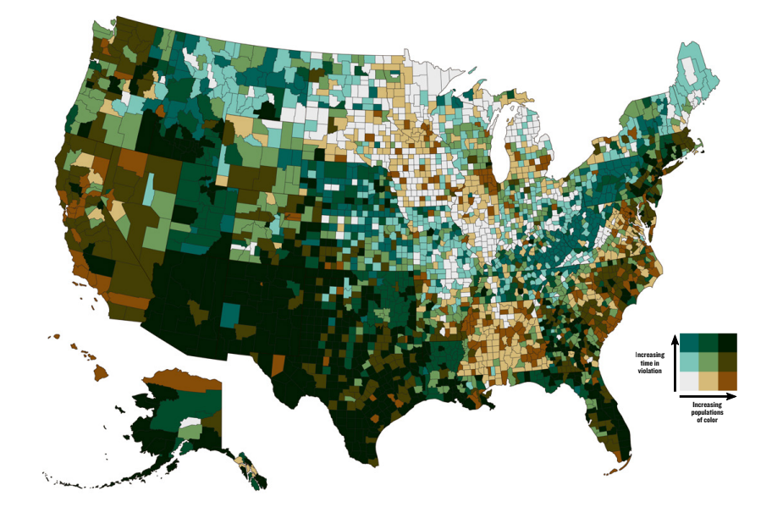
These same communities are 40% more likely to be in chronic non-compliance, or active violation for 12 consecutive quarters.

Slide 29
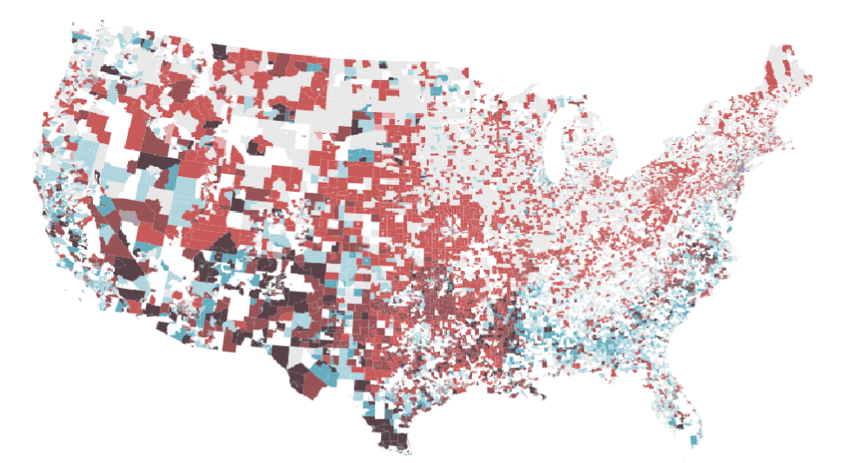
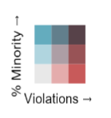
A related bivariate map using health-based violations from 2015-2023 and more geospatially-precise service areas.

Slide 30
Part 3: Frontiers in Drinking Water

Slide 31
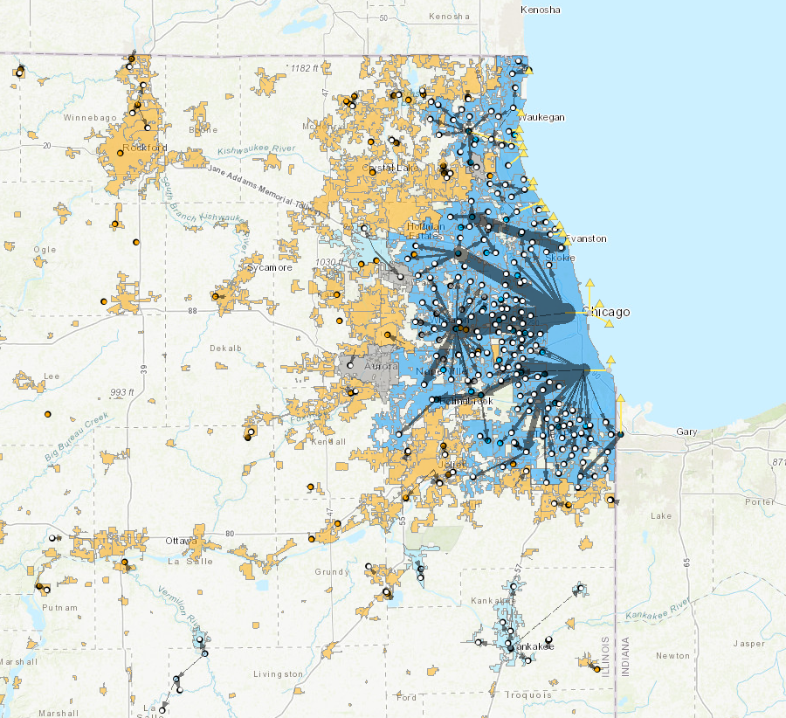
Service Boundaries
Service boundaries approximate the geographic extent of a community water system customer base.
They allow us to join water quality data to:
Demographic characteristics.
Economic disadvantage.
EJSCREEN vulnerability indicators.
Figure: Service Boundaries in the Greater Chicago Region. Water purchase links in blue.

Slide 32
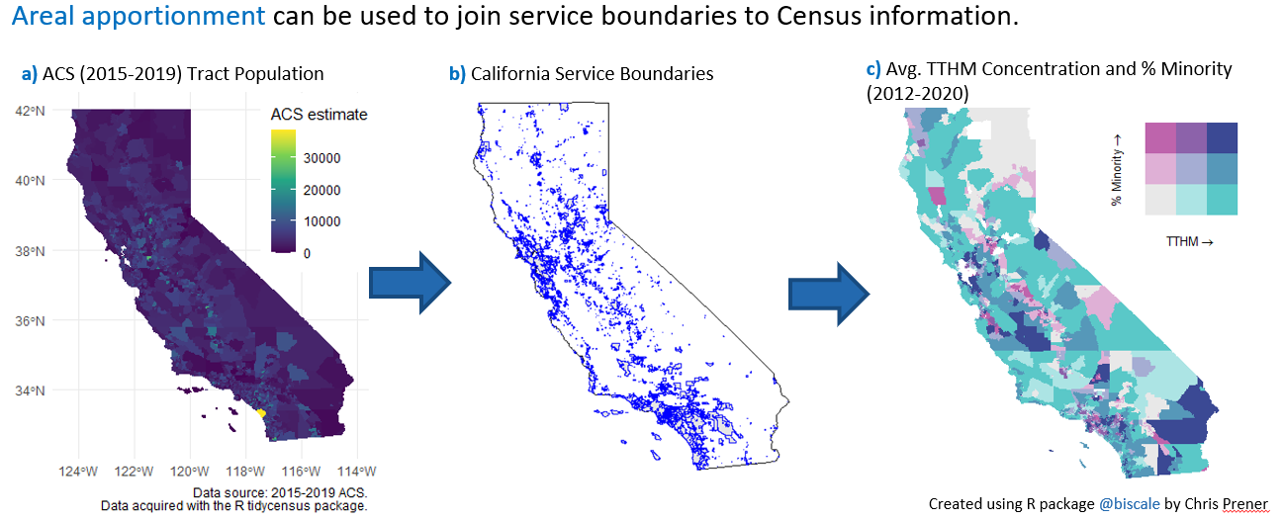
Combining Demographics and Water Quality

Slide 33
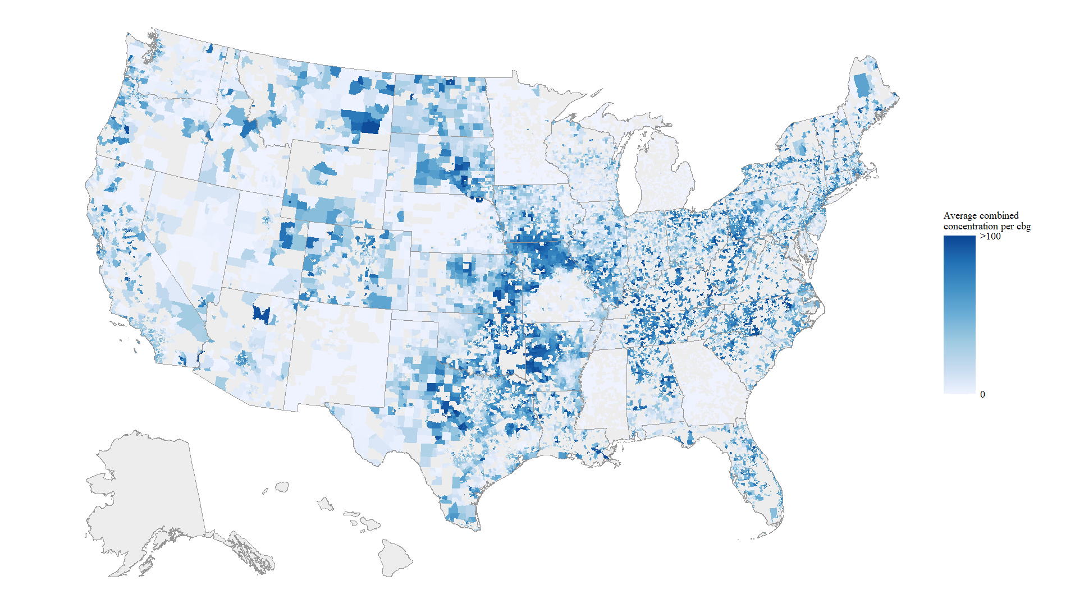
Moving Beyond Violations: SDWA Compliance Samples

Slide 34
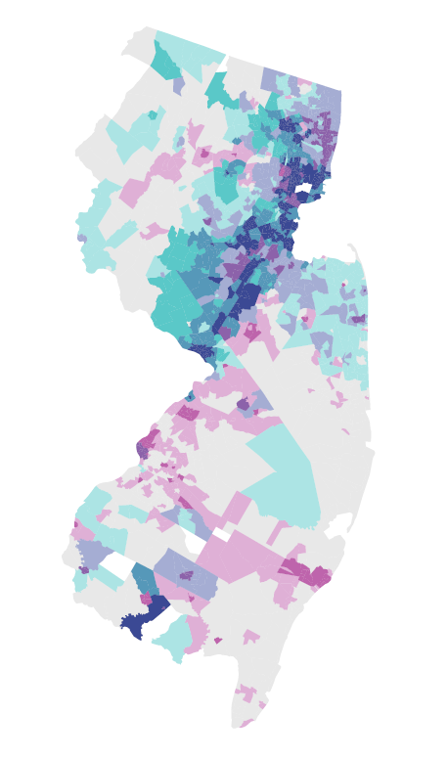
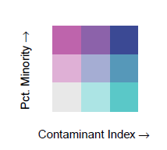
A Simple Contaminant Index in New Jersey
Dark blue census tracts, those in the top third of the distribution for both contaminant index and percent minority, have high EJSCREEN vulnerability indicators.
EJSCREEN Indicator (2021) | Average over Dark Blue Tracts | State Average | National Average
Pct. Minority | 46.7 | 23.9 | 31.4
Pct. Low Income | 81.5 | 44.9 | 39.9
Pct. Linguistic Isolation | 17.1 | 7.2 | 5.4
PM 2.5 | 8.8 | 8.3 | 8.7
Traffic Proximity | 1386.3 | 852.2 | 705.0
Pct pre-1960 Housing | 59.6 | 41.1 | 27.2
Figure: Contaminant Index and % Minority in New Jersey
Notes: Population-weighted averages reported.
Data Source: https://gaftp.epa.gov/EJSCREEN/2021/

Slide 35
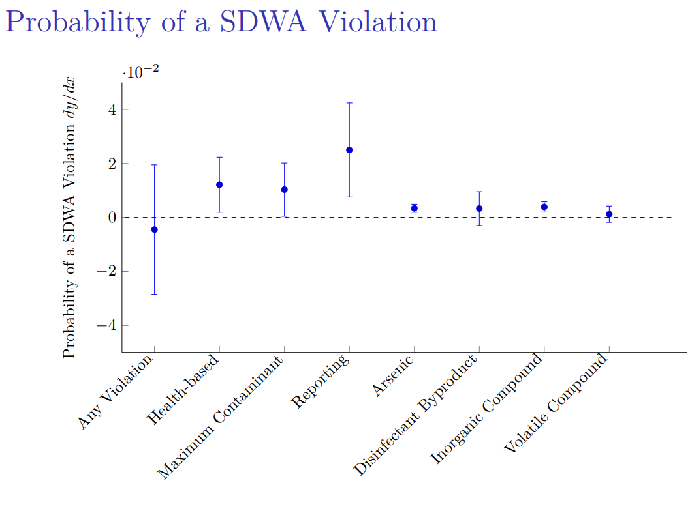
A figure from my dissertation showing the effects of coal ash effluents on drinking water quality in the Southeast.
It shows increases in SDWA violations in years when effluent was released upstream.

Slide 36
Recap
There is much work to be done re: economics and drinking water. A few key areas:
Using more geospatially precise water system information.
Move from violations to samples.
Expand the number of contaminants.
Assess the root causes of non-compliance.
Investigate health outcomes.

Slide 37
Part 4: Case Study #4 on the PFAS Drinking Water Rule

Slide 38
What Are Per- and Polyfluoroalkyl Substances (PFAS)?
PFAS refers to a large class of synthetic chemicals.
Chains of carbon atoms surrounded by fluorine atoms.
Used in homes, businesses, and industry since the 1940s.
Detected in soil, water, and air samples.
Most people have been exposed to PFAS.
Resist decomposition in the environment and in the human body (“forever chemicals”).
Known or suspected toxicity.
Potential developmental, reproductive, liver, immune, thyroid, cardiovascular, and kidney effects.
Some are relatively well understood; many others are not.

Slide 39
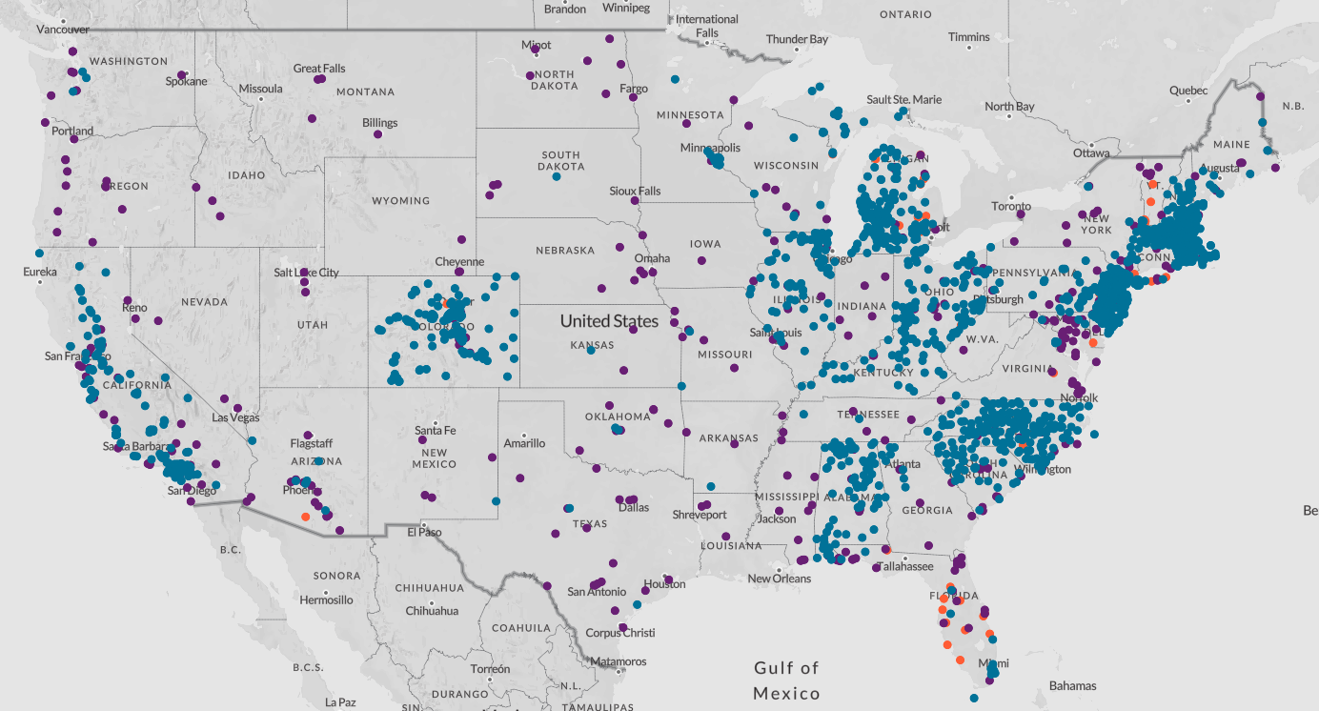
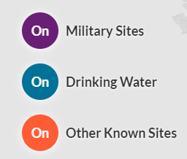
Environmental Working Group’s PFAS Interactive Map

Slide 40
Case Study #4
This is a unique assignment. It asks your group to fill the role of an EPA economist working on a major regulation.
Synthesize diverse materials.
Focus on the economic analysis and the AWWA comment.
Provide a policy recommendation grounded in your understanding of economics, cost-benefit analysis, and environmental justice analysis.
Recommendation must be short and to the point.
There is no right answer, but there are wrong answers.

Slide 41
Next class
Your final reflection post is due by midnight tonight.
Next class will cover the Toxic Substances Control Act.
Readings for Monday:
Shapira and Zingales (2023)
(optional) Shavell (1984)

